Slide 1
Computer Modeling and Simulation

Slide 2
Constrained Growth Model
Endemic populations increase rapidly at first, but they eventually encounter resistance from the environment— competitors, predators, limited resources, and disease.
Thus, the environment tends to limit the growth of populations, so that they usually increase only to a certain level and then do not increase or decrease drastically unless a change in the environment occurs.
This maximum population size that the environment can support indefinitely is termed the carrying capacity.

Slide 3

Carrying Capacity
In unconstrained growth model, we have
When the population is very small, the number of deaths be almost zero, indicating that few individuals are dying.
Near the carrying capacity, the number of deaths should be almost equal to the number of births, so that the population remains roughly constant.

Slide 4
Carrying Capacity
For populations larger than the carrying capacity, the fraction should be even larger so that the population decreases in size through deaths.
To accomplish this dampening of growth, we could compute the number of deaths as a changing fraction of the number of births.
This fraction is P/M where P is the population at any instant and M is carrying capacity.

Slide 5


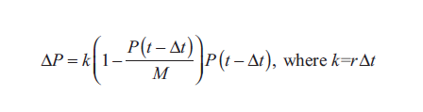
Logistic Equations
Thus, we can model the instantaneous rate of change of the number of deaths (D) as the fraction P/M times the instantaneous rate of change of the number of births (r), as the following differential equation indicates:
1
2

Slide 6
Carrying Capacity
Differential equation (1) and difference equation (2) are called logistic equations.
An equilibrium solution for a differential equation is a solution where the derivative is always zero. An equilibrium solution for a difference equation is a solution where the change is always zero.

Slide 7
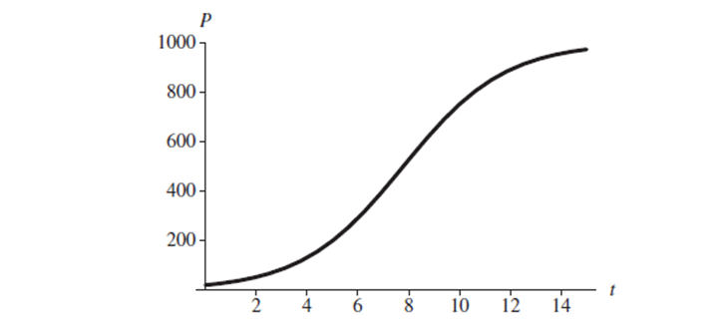
Graph of logistic equation where initial population is 20, carrying capacity is 1000
and instantaneous rate of births is 50% with time in years

Slide 8
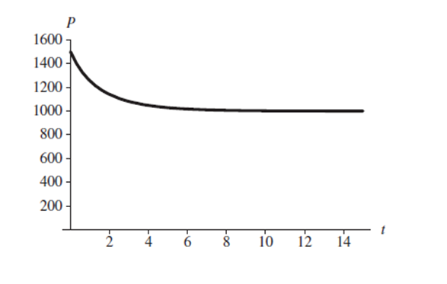
Graph of logistic equation where initial population is 1500, carrying capacity is 1000
and instantaneous rate of births is 50% with time in years

Slide 9
SYSTEM DYNAMICS MODELS WITH INTERACTIONS
Competition is the struggle between individuals of a population or between species for the same limiting resource.
If one individual (species) reduces the availability of the resource to the other, we term that type of competition exploitative, or resource depletion. This interaction is indirect and may involve removal of the resource or denial of living space.
If there is direct interaction between individuals (species), where one interferes with or denies access to a resource, we term that competition interference. In this form, there may be physical contests for reso

Slide 10
Modeling Competition
Sometimes two species are not eating each other but are competing for the same limited food source.
For example, whitetip sharks (WTS) and blacktip sharks (BTS) in an area might feed on the same kinds of fish in a year when the fish supply is low.
A large increase in one species, such as BTS, might have a detrimental effect on the ability of the other species, such as WTS, to obtain an adequate amount of food and, therefore, to thrive.
Also, we expect that superior hunting skills of one species would diminish the food supply for the other species.
As one species grows, the other shrinks, and vice versa

Slide 11
Modeling Competition
In an unconstrained growth model, which ignores competition and limiting factors, we consider a population’s (P) births to be proportional to the number of individuals in the population (r₁P) and its deaths to follow a similar proportionality (r₂P).
Thus, in this model, the rate of change of the population is
dP/dt = r₁P – r₂P = (r₁ – r₂)P
The solution is an exponential function, P = P₀e^{(r1 – r2)t}.
However, with competition, a competing species has a negative impact on the rate of change of a population.

Slide 12
Modeling Competition
In this situation, we can model the number of deaths of each species as being proportional to its population size and the population size of the other species.
Thus, for B being the population of BTS and W the population of WTS, the number of deaths of each species is proportional to the product BW.
Moreover, the constant of proportionality associated with this proportionality for one species reflects competitive skills of the other species.

Slide 13
Modeling Competition
In this situation, we can model the number of deaths of each species as being proportional to its population size and the population size of the other species.
Δ(deaths of WTS) = wBW, where w is a WTS death proportionality constant
Δ(deaths of BTS) = bWB where b is a BTS death proportionality constant

Slide 14
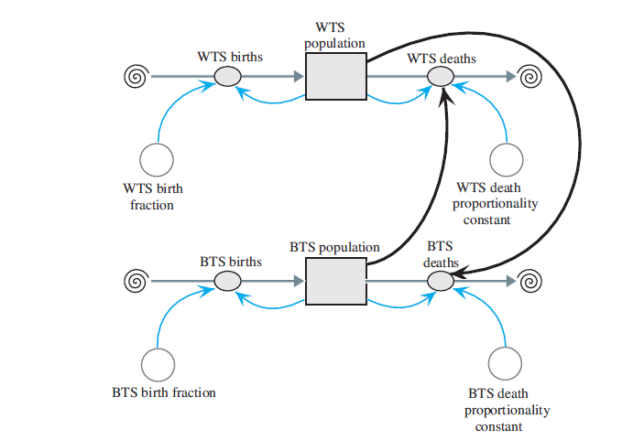
Model diagram of competition of species

Slide 15
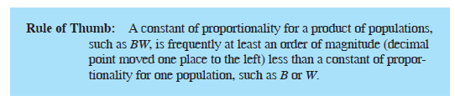
Equation Set
BTS_population(0) = 15
BTS_birth_fraction = 1
BTS_births = BTS_birth_fraction * BTS_population
BTS_death_proportionality_constant = 0.20
BTS_deaths = (BTS_death_proportionality_constant * WTS_population) * BTS_population
WTS_population(0) = 20
WTS_birth_fraction = 1
WTS_births = WTS_population * WTS_birth_fraction
WTS_death_proportionality_constant = 0.27
WTS_deaths = (WTS_death_proportionality_constant * BTS_population) * WTS_population

Slide 16
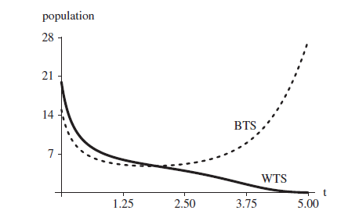
Graph of population change of BTS and WTS over time

Slide 17
Predator-Prey Model
When one species (predator) consumes another species (prey) while the latter is still living, the action is predation.
Predator adaptations usually involve better prey detection and capture, whereas prey adaptations normally involve improved abilities to escape and avoid detection.
In the 1920s, mathematicians Vito Volterra and Alfred Lotka independently proposed a model for populations of a predator species and its prey, such as hawk and squirrel populations in a certain area.
This model is called Lotka-Volterra Model.

Slide 18
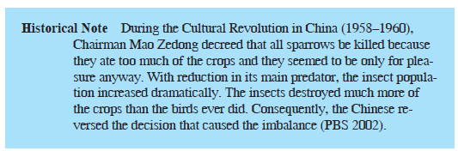

Slide 19
Lotka-Volterra Model
Let s be the number of squirrels in the area and h be the number of hawks. If no hawks are present, the change in s from time t – Δt to time t is
Δs = s(t) – s(t - Δt)
= (squirrel growth at time t – Δt) * Δt
= k_{s} * s(t – Δt) * Δt for constant k_{s}
However, this prey’s population is reduced by an amount proportional to the product of the number of hawks and the number of squirrels, h(t – Δt) * s(t – Δt). Thus, with a proportionality constant k_{hs} for this reduction, the change in the number of squirrels from time t – Δt to time t is as follows:
Δs = s(t) – s(t – Δt)
= (squirrel growth at time t – Δt) * Δt
= (k_{s} * s(t – Δt) – k_{hs} * h(t – Δt) * s(t – Δt)) * Δt

Slide 20
Lotka-Volterra Model
Δh = h(t) – h(t – Δt)
= (hawk growth at time t – Δt) * Δt
= (k_{sh} * s(t – Δt) * h(t – Δt) – k_{h} * h(t – Δt)) * Δt
Although the deaths of the squirrels and the births of the hawks are both proportional to the product of the number of possible interactions of the two populations, their constants of proportionality, k_{hs} and k_{sh}, respectively, are probably different. For instance, 2% of the possible interactions might result in the death of a squirrel, while only 1% of the possible interactions might contribute to the birth of a hawk.

Slide 21
Lotka-Volterra Model
We can express the predator-prey model, known as the Lotka-Volterra model,
as the following pair of difference equations for the change in prey (here, change in
the squirrel population, Δs) and change in predator (here, change in the hawk population, Δh) from time t – Δt to time t:
Δs = (k_{s} * s(t – Δt) – k_{hs} * h(t – Δt) * s(t – Δt)) * Δt
Δh = (k_{sh} * s(t – Δt) * h(t – Δt) – k_{h} * h(t – Δt)) * Δt
ds/dt = k_{s} s – k_{hs}hs
dh/dt = k_{sh} sh – k_{h} h

Slide 22
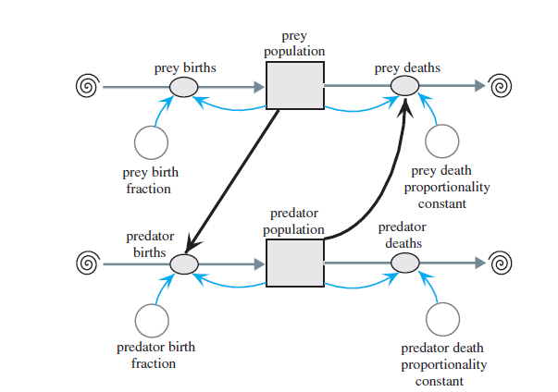
Lotka-Volterra Model
Predator-prey diagram

Slide 23
Equation set
predator_population(0) = 15
predator_birth_fraction = 0.01
predator_births = (predator_birth_fraction * prey_population) * predator_population
predator_death_proportionality_constant = 1.06
predator_deaths = predator_death_proportionality_constant * predator_population
prey_population(0) = 100
prey_birth_fraction = 2
prey_births = prey_birth_fraction * prey_population
prey_death_proportionality_constant = 0.02
prey_deaths = (prey_death_proportionality_constant * predator_population) * prey_population

Slide 24
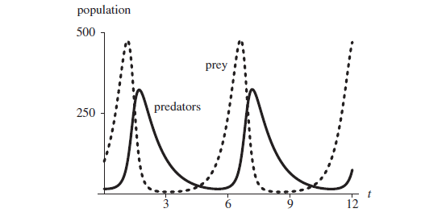
Graph of populations versus time in months

Slide 25
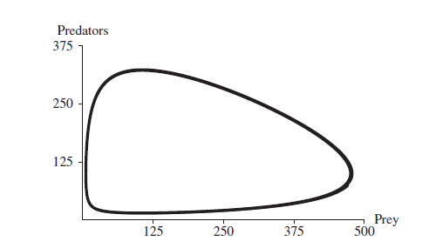
Graph of predator population versus prey population

Slide 26
Force and Motion
We want to model skydiving now.
For that we model velocity and acceleration first.
The instantaneous rate of change, or derivative, of position (s) with respect to time (t) is velocity (v).
Moreover, the instantaneous rate of change of velocity with respect to time is acceleration (a). In derivative notation, we have the following:
We use these derivatives in modeling the motion of a ball when, on a windless day, someone standing on a bridge holds a ball over the side and tosses the ball straight up into the air.

Slide 27
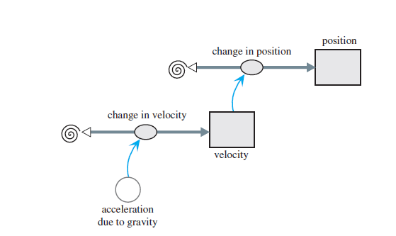
Diagram of motion of ball thrown straight up

Slide 28
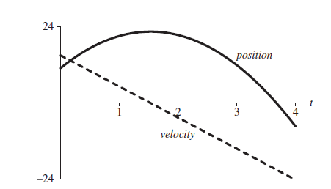
Graph of velocity (m/s) and position (m) of ball versus time (s)

Slide 29
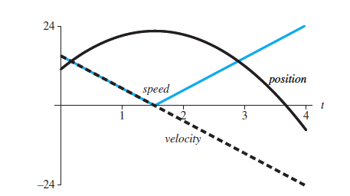
Graph of velocity (m/s), position (m), and speed (m/s) of ball versus time (s)

Slide 30
Force and Motion Model involving friction
Kinetic friction, or drag, is a force. This force between objects is in the opposite direction to a moving object and tends to slow motion. Thus, kinetic friction dampens motion of an object.
When an object moves through a fluid, such as air or water, the fluid friction is a function of the object’s velocity. For example, the faster we pedal a bicycle, the harder it is for us to do so. As our velocity increases, so does the friction of the air on our bodies

Slide 31
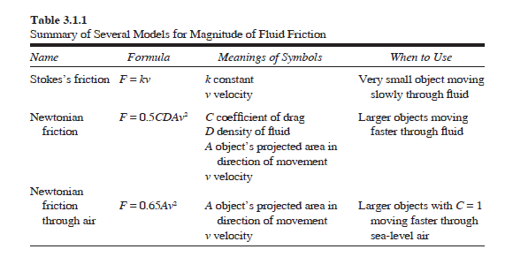
Different models for fluid friction

Slide 32
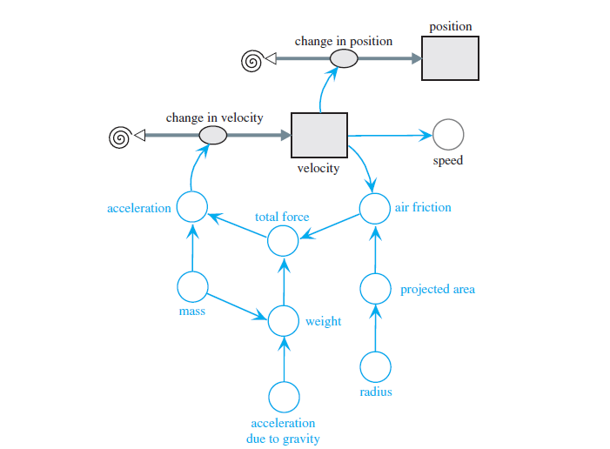
Diagram for motion of ball under influence of air friction

Slide 33
Equation Set for friction during fall model
mass = 0.5 kg
acceleration_due_to_gravity = –9.81 m/s2
radius = 0.05 m
weight = mass * acceleration_due_to_gravity
projected_area = 3.14159 * radius^2
air_friction = –0.65 * projected_area * velocity * ABS(velocity)
total_force = weight + air_friction
acceleration = total_force/mass
change_in_velocity = acceleration
change_in_position = velocity
speed = ABS(velocity)
velocity(0) = 0 m/s
velocity(t) = velocity(t – Δt) + (change_in_velocity) * Δt
position(0) = 400 m
position(t) = position(t – Δt) + (change_in_position) * Δt

Slide 34
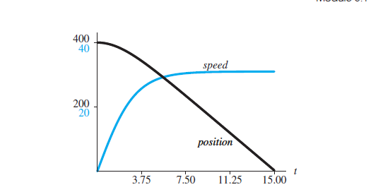
Graph of position (m) and speed (m/s) of object versus time (s) under influence of friction

Slide 35
Modeling Skydive
For simplicity, we consider someone jumping out of a stationary helicopter at 2000 m (about 6562 ft), and we ignore changes in air density.
The model for a skydive out of a helicopter has two phases.
For our model, the main difference in these two phases is the projected area in the direction of motion, down.
One where the person is in a free fall
The crosssectional area of a jumper in the stable arch position with arms arched back and legs bent at the knees is approximately 0.4 m2 (about 4.3 ft2).
The other after the parachute opens, when the larger surface area results in more air resistance.
Parachutes vary in their designs, but 28 m2 (about 301 ft2) is a reasonable value.
We trigger the pull of the ripcord by the height (position) above the ground, say, 1000 m (about 3281 ft).
Thus, the diagram contains a converter/variable (position_open) for this quantity and nectors/arrows from position to position_open and from position_open to projected_area.

Slide 36
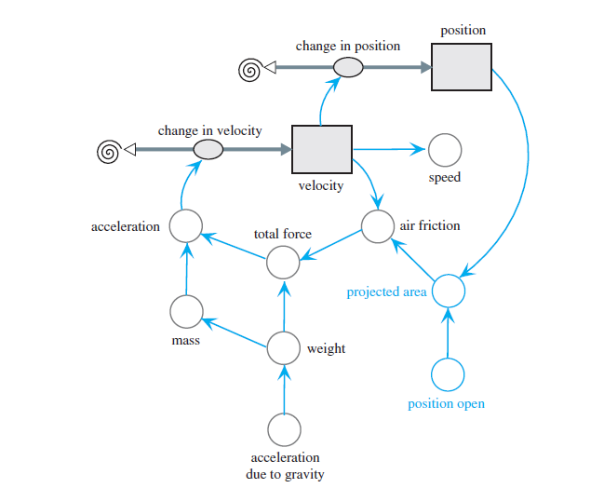
Modeling Skydive
if (position > position_open)
projected_area ← 0.4
else
projected_area ← 28
Diagram of skydiver’s motion under influence of air friction

Slide 37
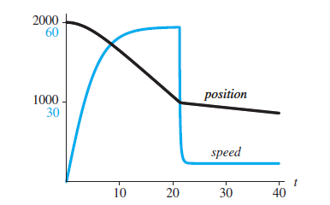
Position (m) and speed (m/s) versus time (s) of skydiver

